Slide 1
Development and Application of VVUQ Roadmap with Systematic Simulation and Experimental Campaigns Preliminary Demonstration: Granular Hopper Discharge
A. Vaidheeswaran (ORISE/NETL), A. Gel (ALPEMI/NETL),
J. Musser (NETL), C. Tong (LLNL)

Slide 2
Motivation
Scope of ASME V&V 20
“the quantification of the degree of accuracy of simulation of specified validation variables at a specified validation point for cases in which the conditions of the actual experiment are simulated. Consideration of solution accuracy at points within a domain other than the validation points, is a matter of engineering judgment specific to each family of problems and is beyond the scope of this Standard.”
Application of V&V standards for multiphase flow modeling and simulation has faced several challenges
Complex hydrodynamics and interphase interactions
Diverse spatio-temporal scales involved
Existence of many modeling parameters
Assessing uncertainty due to various sources (e.g. numerical discretization, models)
Lack of objectively-assessed experimental uncertainty

Slide 3
Outline
Development and application of a systematic VVUQ approach
Need for extending the existing Standards
Survey of subject matter experts and tollgates for review
Design of experiments for systematic simulation and experiment campaigns
Benchmark problem and preliminary experiments: Hopper discharge
Bench-scale experiments to enable a quick turnaround for Discrete Element Modeling (DEM) simulations
Design criteria to ensure mass flow operation mode
Preliminary results from MFIX-DEM simulation campaign
Screening study for identifying the most important factors qualitatively
Sensitivity analysis of model parameters on the quantities of interest

Slide 4
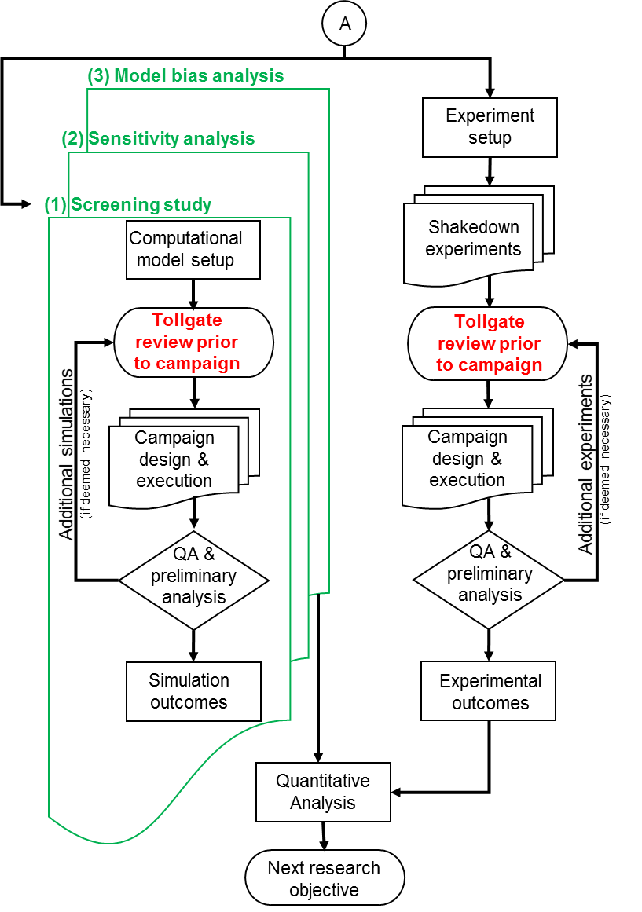
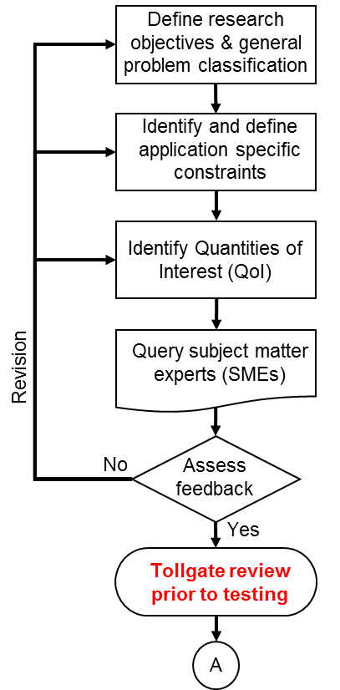
Extended VVUQ roadmap for multiphase flows - NETL

Slide 5
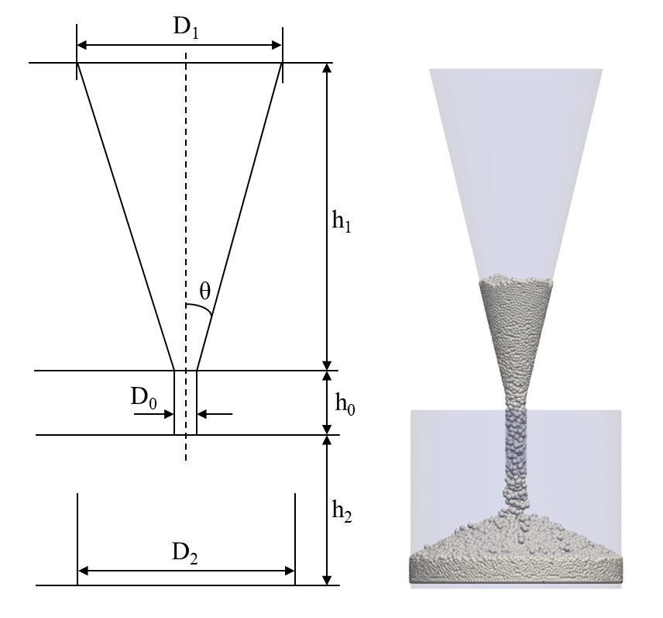
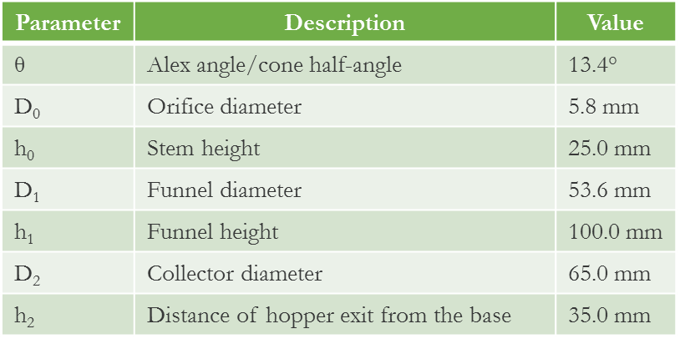
Benchmark problem – Hopper flow
Granular discharge through conical hopper commonly seen in industries (chemical, pharmaceutical, food, mining)
Solution methodology: Alternating use of Force-displacement law and Newton’s second law of motion. Time step size based on spring stiffness provided by the user (fixed).
Simplified hydrodynamics to focus on particle-particle and particle-wall interactions. Interfacial gas is neglected (High Bagnold number).
Isolating uncertainties due to model parameters related to particle-particle and particle-wall interactions from the other sources including spatio-temporal discretization

Slide 6
Survey of Subject Matter Experts
Survey pertaining to experiments and DEM simulations was carried out with the subject matter experts to collaboratively identify:
Quantities of interest (or response variables)
Control variables, which are to be varied systematically
Held-constant factors for experiments and modeling
Known nuisance factors for the experiments
Based on the feedback, 10 control variables were identified for DEM simulations as important but without any consistent and objective ranking of importance
No agreement among subject matter experts in importance ranking
Screening study performed to identify the most influential parameters on the response variables

Slide 7
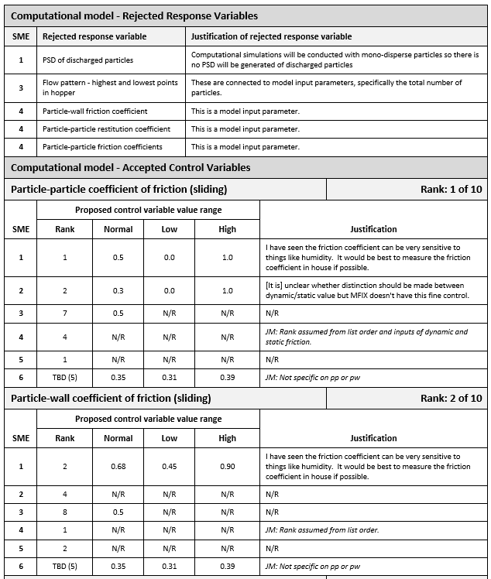
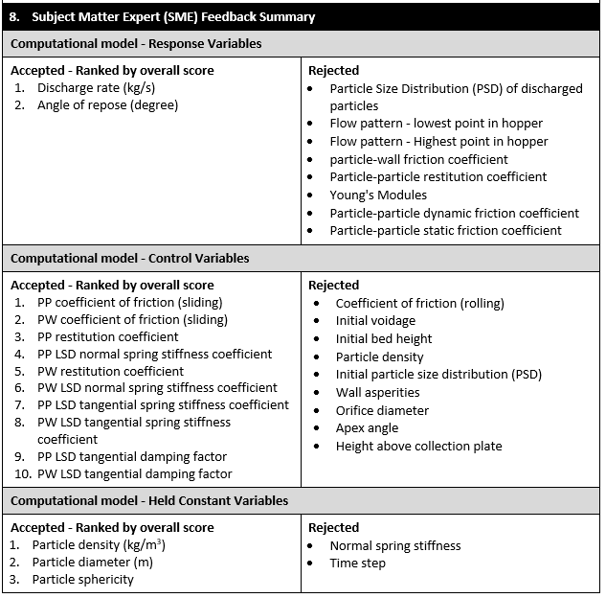
Example illustration of survey: - Identification and Characterization of Control Variables for CFD Simulations:

Slide 8
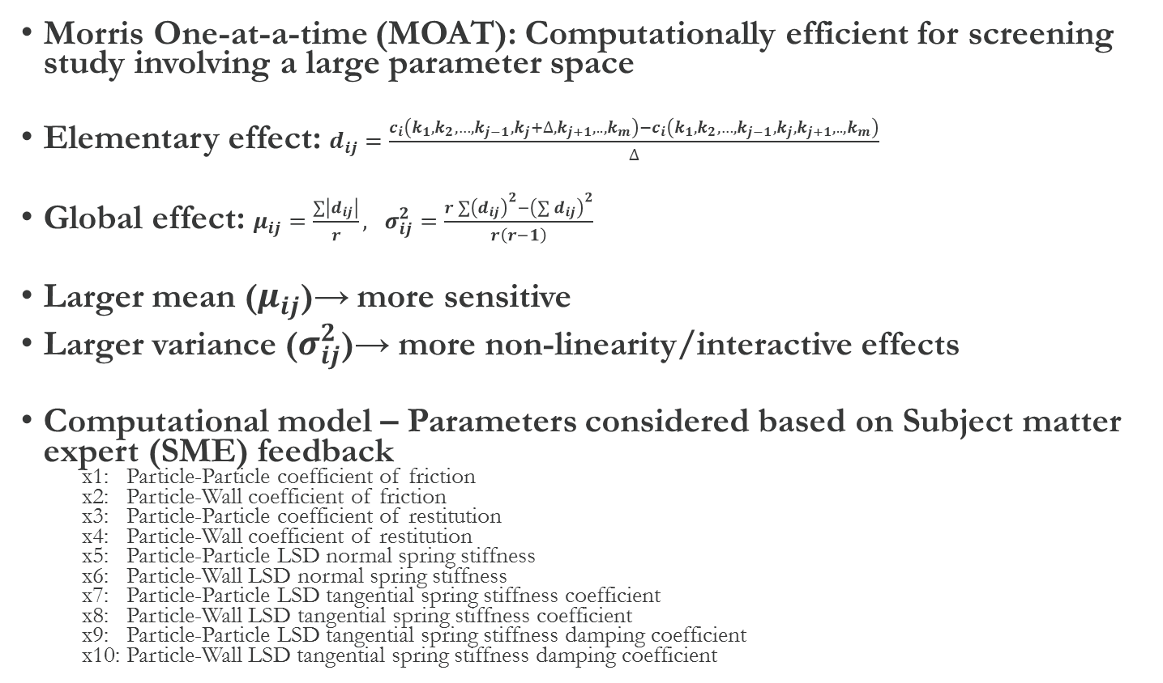
Screening study
Morris One-at-a-time (MOAT): Computationally efficient for screening study involving a large parameter space
Elementary effect: $d_{ij}=\frac{c_{i}\left(k_{1},k_{2},…,k_{j−1},k_{j}+∆,k_{j+1},..,k_{m}\right)−c_{i}\left(k_{1},k_{2},…,k_{j−1},k_{j},k_{j+1},..,k_{m}\right)}{∆}$
Global effect: $μ_{ij}=\frac{\sum{\left|d_{ij}\right|}}{r}, σ_{ij}^{2}=\frac{r\sum{{\left(d_{ij}\right)}^{2}−}{\left(\sum{d_{ij}}\right)}^{2}}{r\left(r−1\right)}$
Larger mean ($μ_{ij}$)→ more sensitive
Larger variance ($σ_{ij}^{2}$)→ more non-linearity/interactive effects
Computational model – Parameters considered based on Subject matter expert (SME) feedback
x1: Particle-Particle coefficient of friction
x2: Particle-Wall coefficient of friction
x3: Particle-Particle coefficient of restitution
x4: Particle-Wall coefficient of restitution
x5: Particle-Particle LSD normal spring stiffness
x6: Particle-Wall LSD normal spring stiffness
x7: Particle-Particle LSD tangential spring stiffness coefficient
x8: Particle-Wall LSD tangential spring stiffness coefficient
x9: Particle-Particle LSD tangential spring stiffness damping coefficient
x10: Particle-Wall LSD tangential spring stiffness damping coefficient

Slide 9
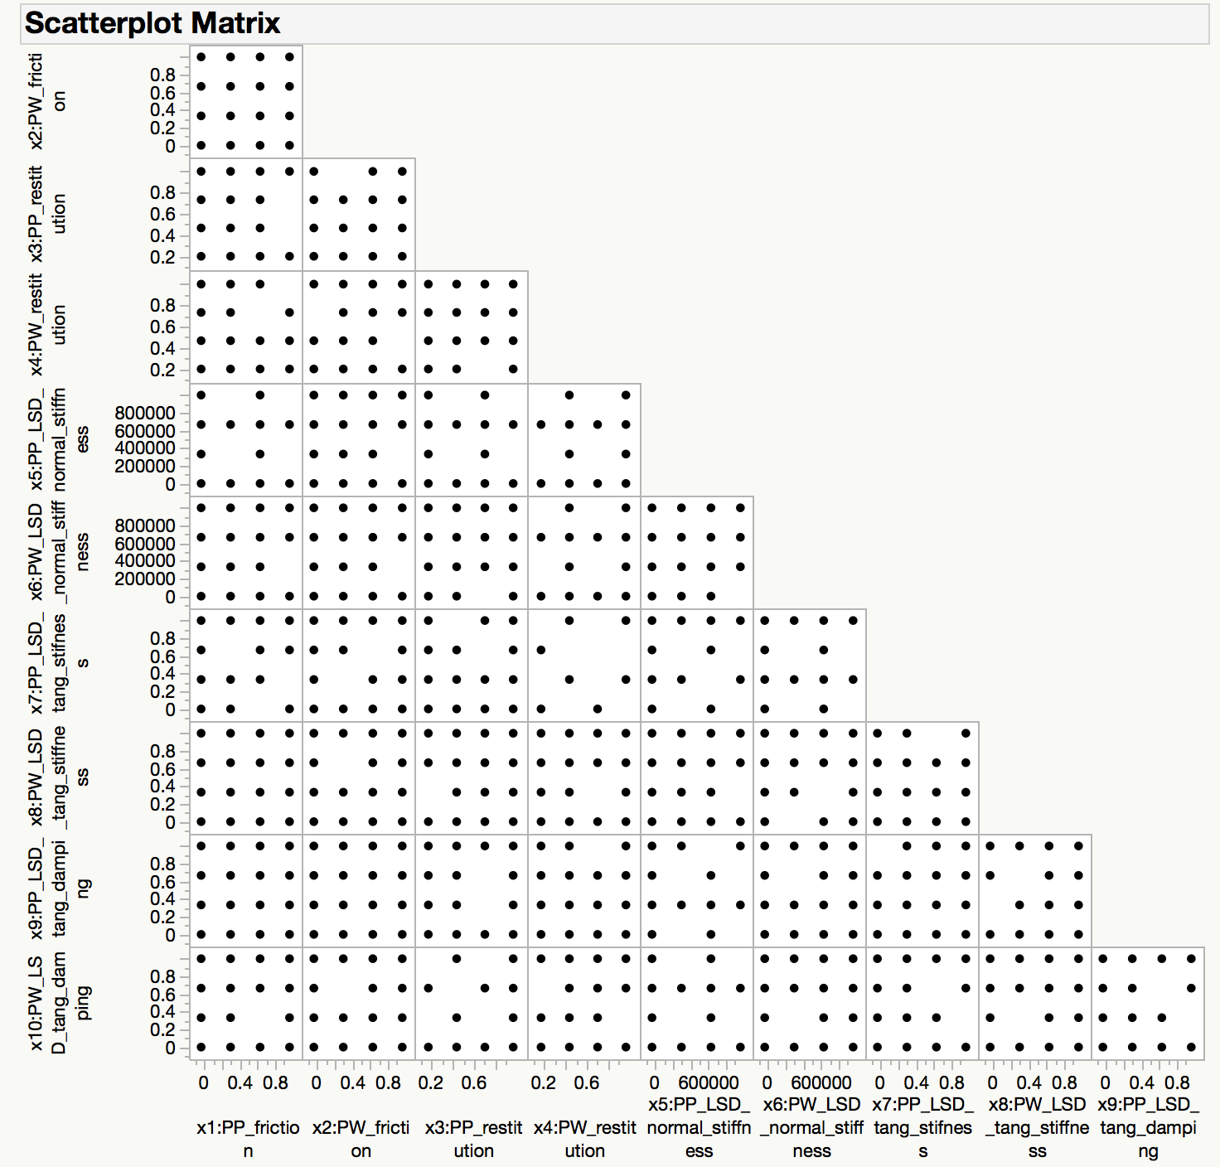
Screening study – Sampling
 | Uncertain input parameter | Lower bound | Upper bound
x1 | PP friction coefficient [−] | 0 | 1
x2 | PW friction coefficient [−] | 0 | 1
x3 | PP restitution coefficient [−] | 0.2 | 0.99
x4 | PW restitution coefficient [−] | 0.2 | 0.99
x5 | PP normal spring stiffness [N/m] | 1.0E+02 | 1.0E+06
x6 | PW normal spring stiffness [N/m] | 1.0E+02 | 1.0E+06
x7 | PP tangential spring stiffness coefficient [−] | 0.1 | 0.9
x8 | PW tangential spring stiffness coefficient [−] | 0.1 | 0.9
x9 | PP tangential damping factor [−] | 0.1 | 0.9
x10 | PW tangential damping factor [−] | 0.1 | 0.9
Morris method (MOAT)
No. of input parameters : 10
Preferred no. of trajectories: 10
Preferred sample size: 110

Slide 10
Screening study – Results
Rank | N=44 | N=55 | N=77 | N=110
1 | x3 | x3 | x3 | x3
2 | x1 | x1 | x1 | x1
3 | x2 | x2 | x2 | x2
4 | x9 | x4 | x4 | x4
5 | x6 | x9 | x9 | x9
6 | x4 | x6 | x6 | x10
N = 44
N = 55
Ranking order:
1. e_{p-p} , 2. μ_{p-p} , 3. μ_{p-w} , 4. e_{p-w}
Time for completion – 2 days to 2 months depending on k_{n} which determines Δt
k_{n}=100 N/m for global sensitivity analysis based on screening study
N = 77
N = 110

Slide 11
Global Sensitivity Analysis (GSA)
GSA is used to quantify the influence of model parameters and their interactions on response variable(s)
Top four parameters determined from the screening study were selected for GSA
A new set of DEM simulation campaign was designed and executed
Investigating the effect of size
Space-filling design based Optimized Latin Hypercube (OLH) sampling (R library)
Both 40 and 80 sampling simulations were conducted and analyzed
Sobol’ Indices based variance method used for GSA
A surrogate model was constructed to perform quick evaluations of the QoIs
PSUADE UQ toolkit was used to calculate Sobol indices

Slide 12
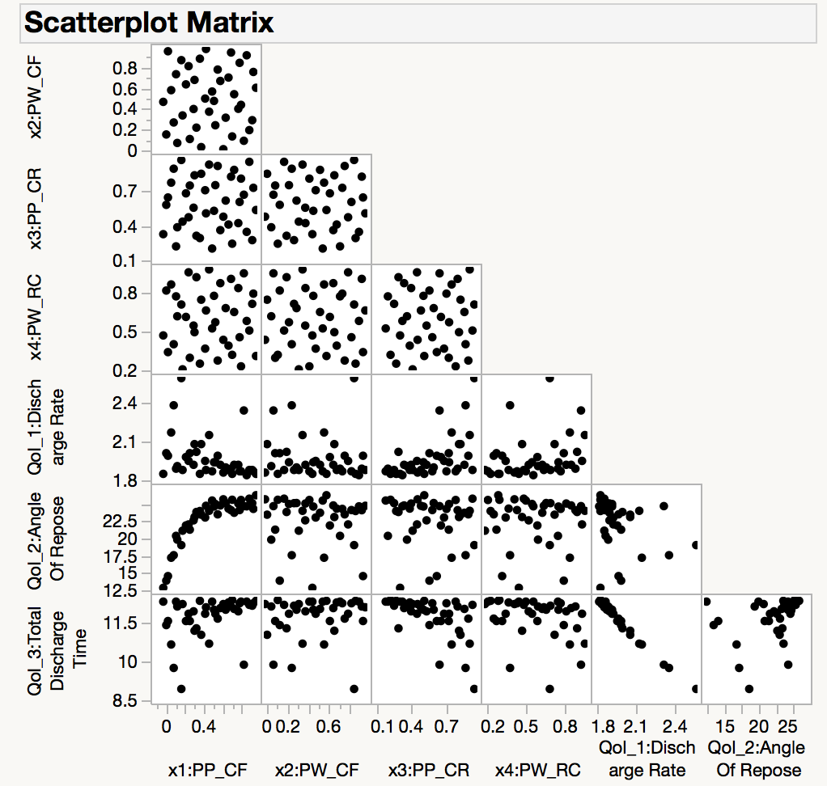
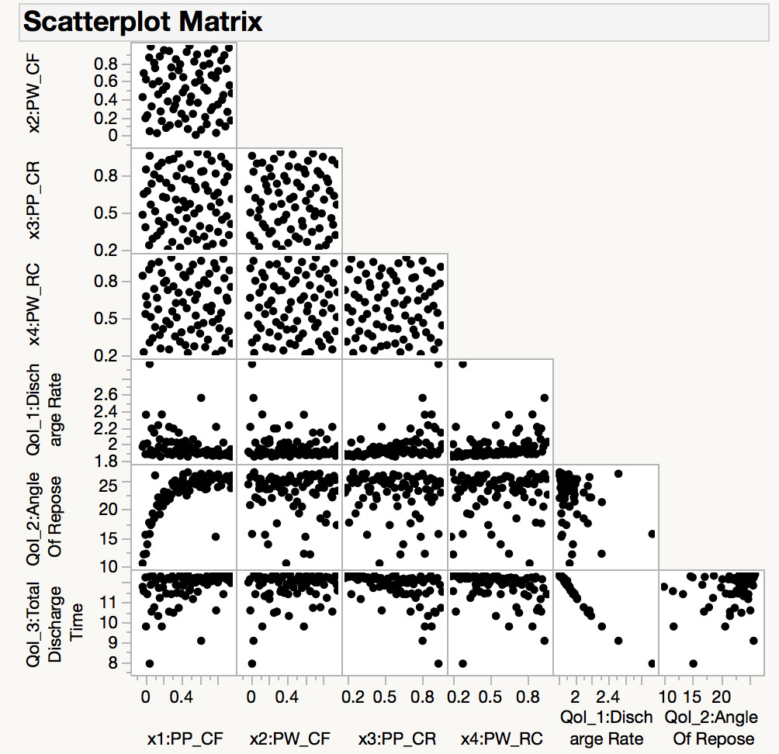
Effect of sampling size on GSA
OLH with 40 samples
OLH with 80 samples

Slide 13
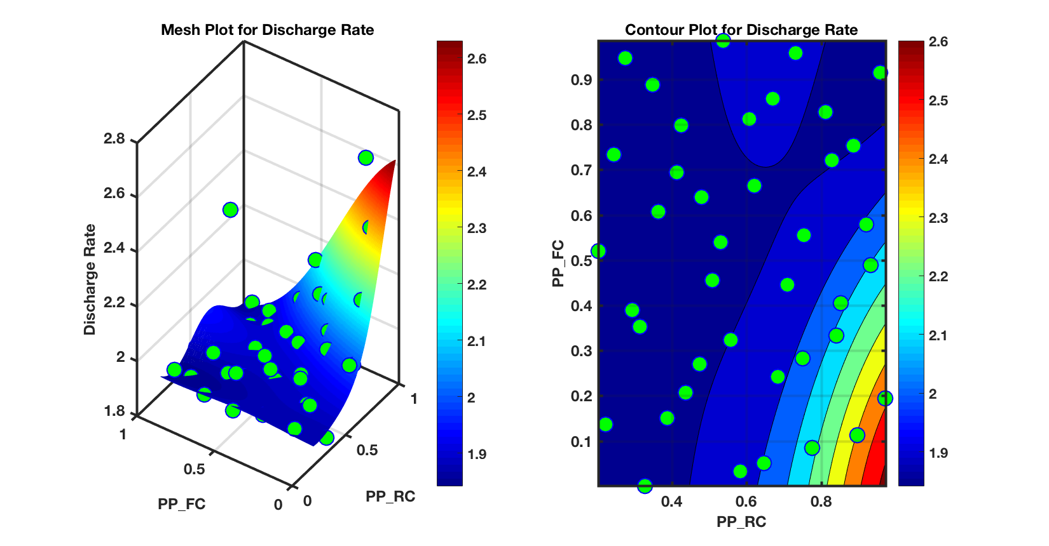
Surrogate model for GSA
Monte Carlo sampling based methods are computationally prohibitive for UQ analysis
Gaussian process based surrogate model built using the OLH sampling simulation results (40 samples)
Note that other two parameters are kept at mid point settings for the construction of surrogate contour plots

Slide 14
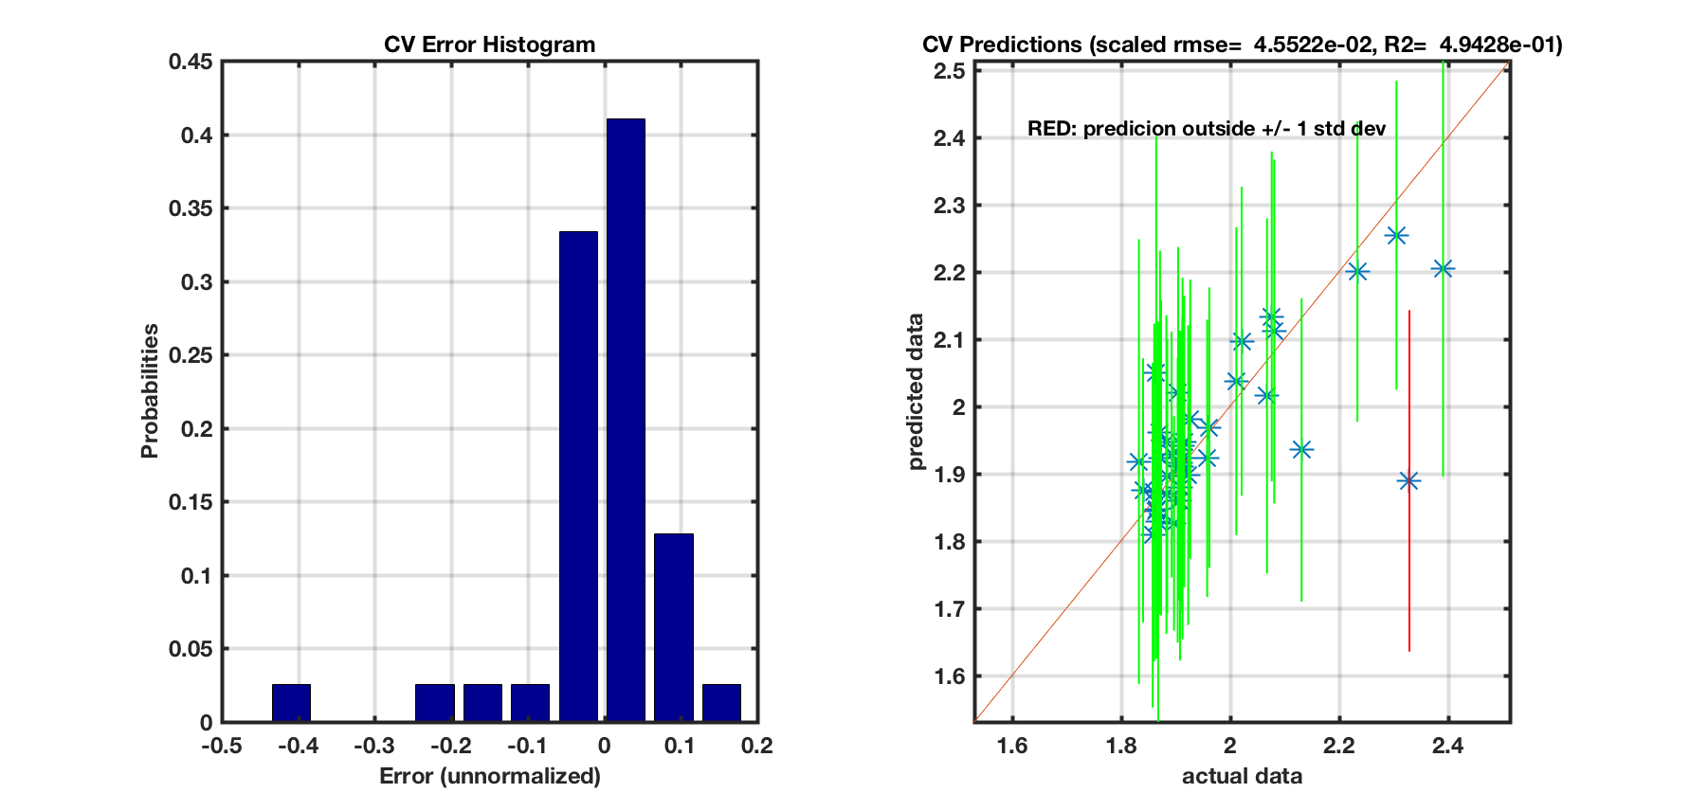
Surrogate model quality
Cross Validation to assess the quality of the surrogate model perform
One sample point outside 1σ

Slide 15
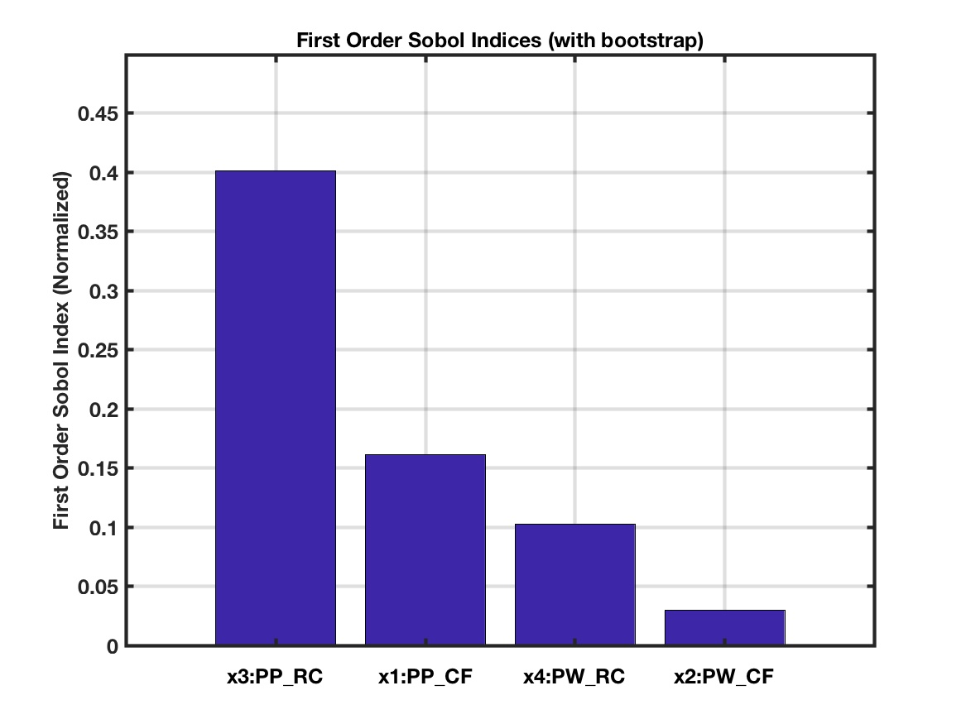
Preliminary GSA results
QoI # 1: Discharge Rate
Variance based sensitivity analysis: Sobols’ Total Indices Method implemented in PSUADE UQ Toolkit using OLH (40 samples)
Under main effects, particle-particle coefficient of restitution is the most influential model parameter
P-P Restitution Coefficient
P-P Coefficient of Friction
P-W Restitution Coefficient
P-W Coefficient of Friction

Slide 16
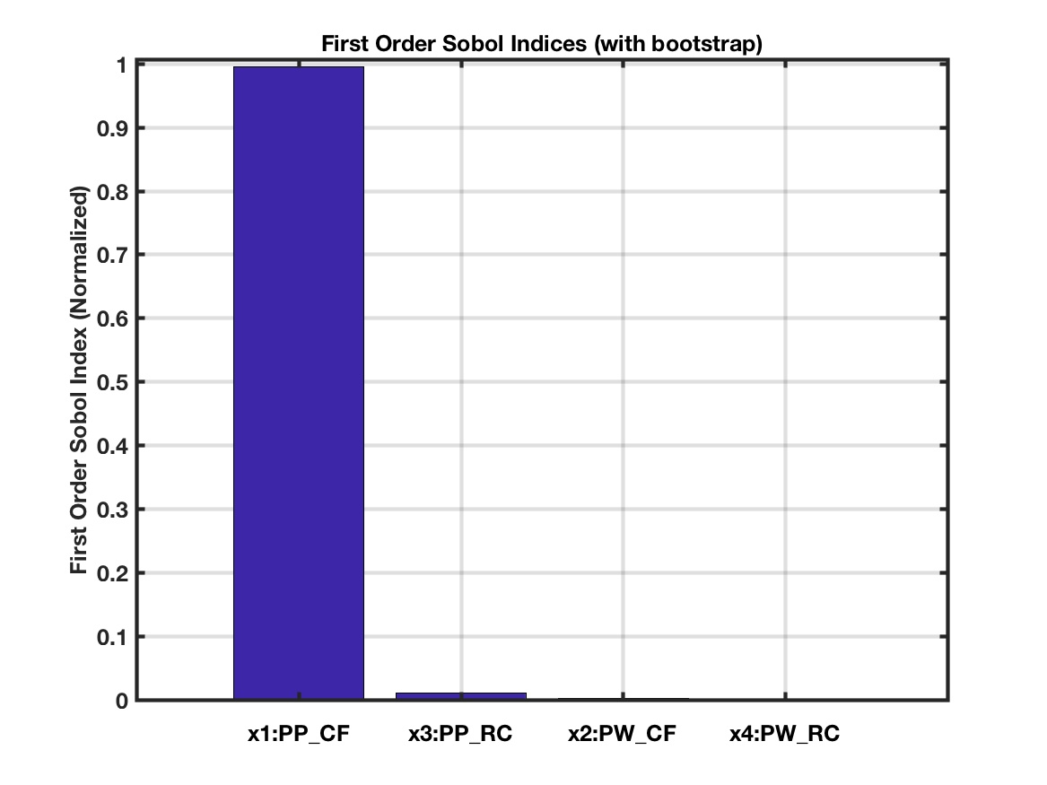
Preliminary GSA results
QoI # 2: Angle of Repose
Variance based sensitivity analysis: Sobols’ Total Indices Method implemented in PSUADE UQ Toolkit using OLH (40 samples)
Under main effects, particle-particle coefficient of restitution is the most influential model parameter

Slide 17
Summary
Extension of VVUQ methodology with systematic design of experiments and simulations (work in progress)
Survey of subject matter experts for VVUQ methodology input
Screening study to shortlist the candidates
Global sensitivity analysis (GSA) to determine the main effects and interactions between different parameters
Ranking of model parameters for hopper discharge based on GSA:
Particle-particle coefficient of restitution
Particle-particle coefficient of friction
Particle-wall coefficient of restitution
Particle-wall coefficient of friction
Thank you for your attention. Questions???

Slide 18
Appendix
Additional backup slides

Slide 19
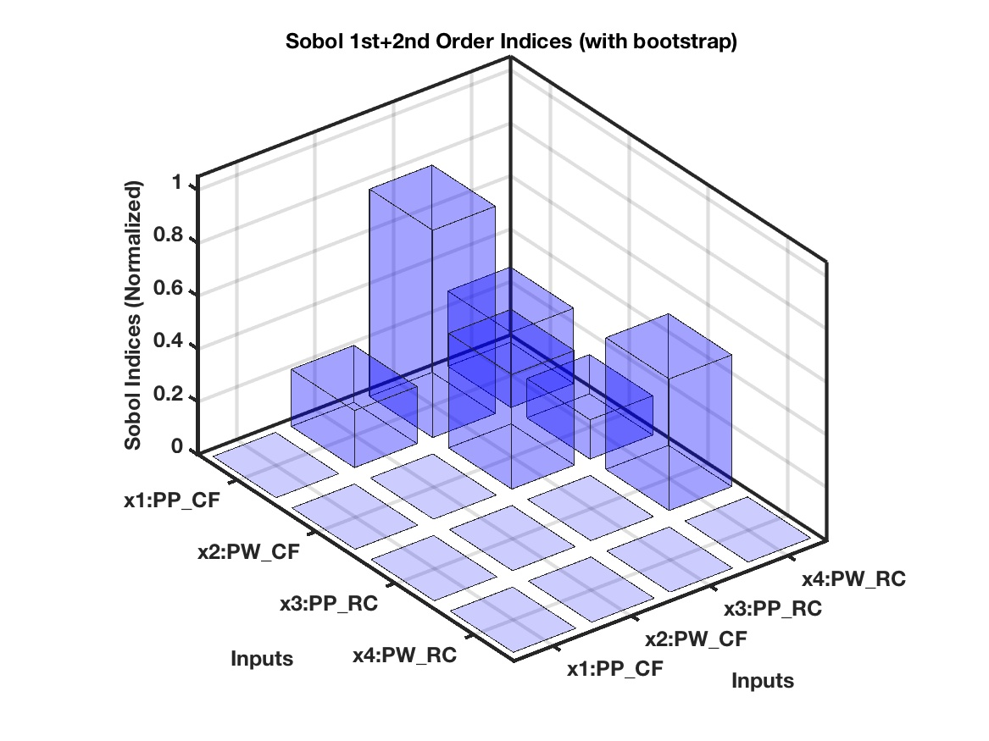
Preliminary GSA results
QoI # 1: Discharge Rate
Interaction effects were also analyzed as part of the Sobols’ method
The interaction of particle-particle coefficient of restitution with particle-particle coefficient of friction is the most pronounced interaction effect on discharge rate.

Slide 20
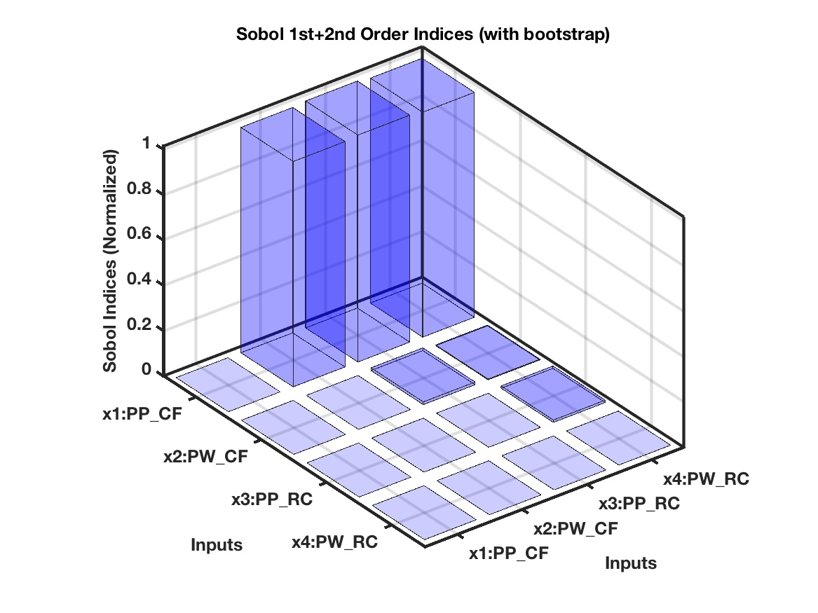
Preliminary GSA results (cont’d)
QoI # 2: Angle of Repose
Interaction effects were also analyzed as part of the Sobols’ method
The interaction among particle-particle coefficient of friction and other parameters individually are significant

Slide 21
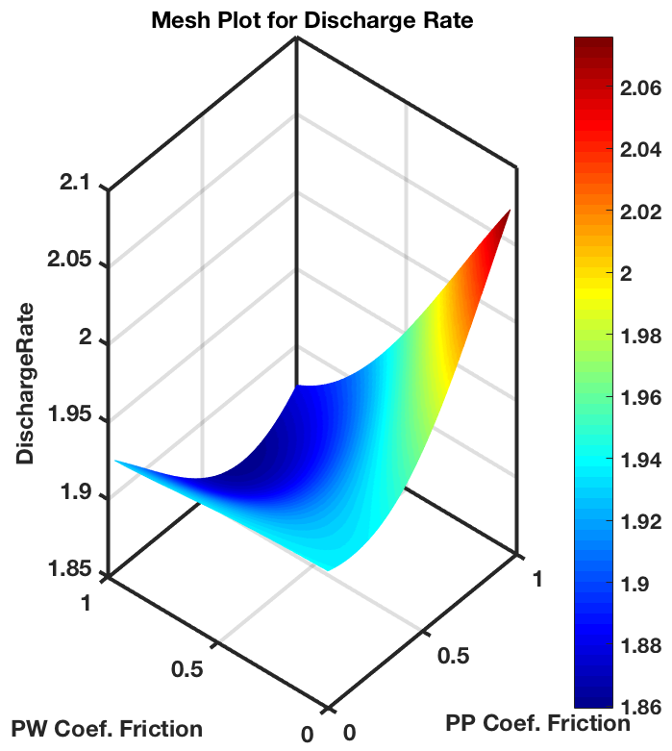
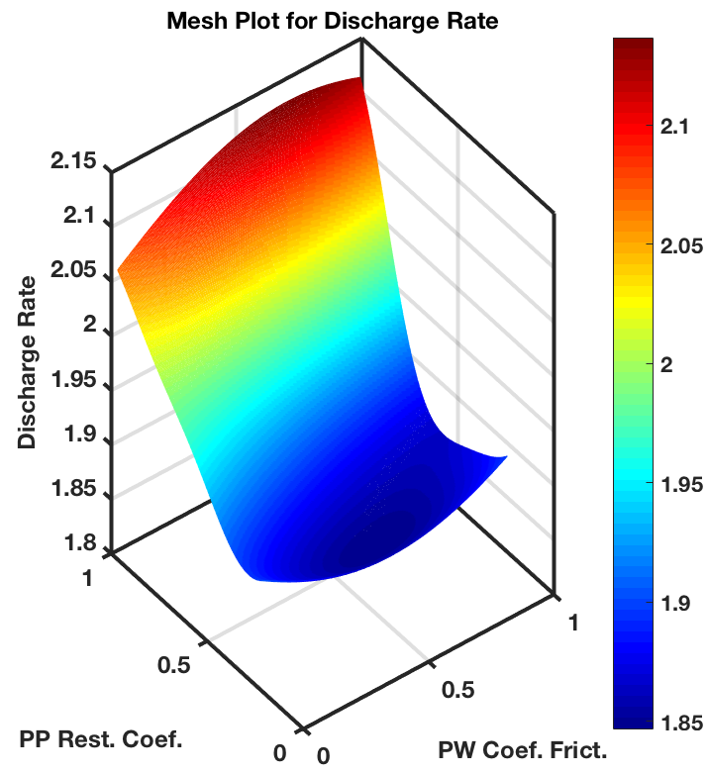
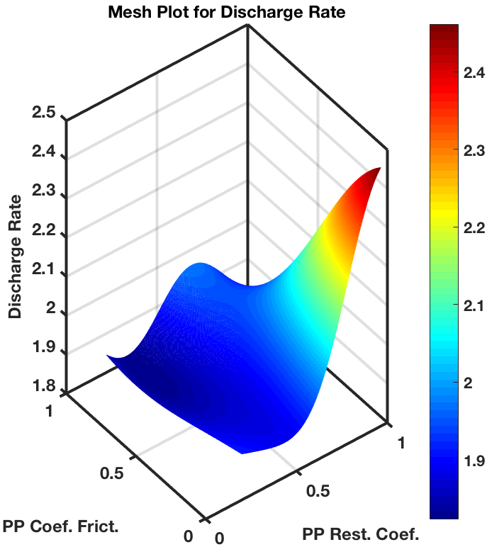
Surrogate model for GSA
Similar Gaussian process based surrogate model constructed for simulation results obtained through LPTAU sampling
Note that other two parameters are kept at mid point settings for the construction of surrogate contour plots

Slide 22
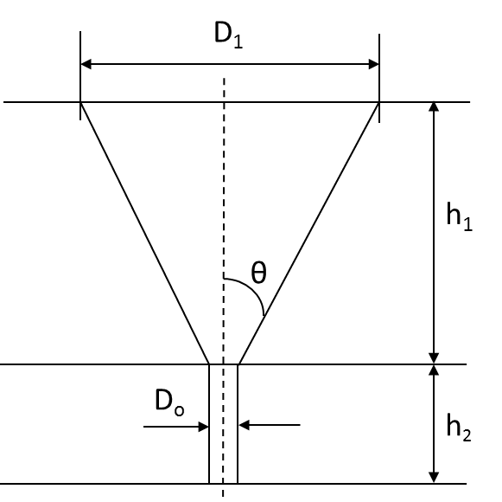
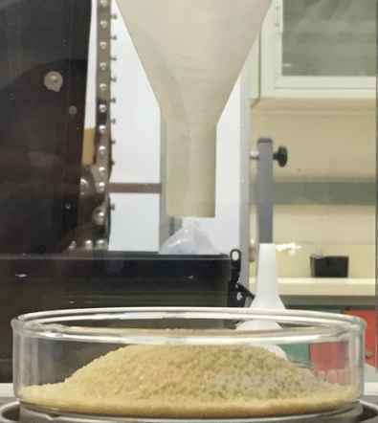
Benchmark problem – Preliminary experiments
Discharge through conical hopper having pure granular flow commonly seen in industries (chemical, pharmaceutical, food, mining)
Simplified hydrodynamics to focus on particle-particle and particle-wall interactions. Interfacial gas neglected (High Bagnold number)
Bench-scale experiments to enable a quick turnaround, 3-D printed geometries to ensure consistency between experiments and simulations
Notes:
Geometry for 3-D printing will be used for simulations

Slide 23
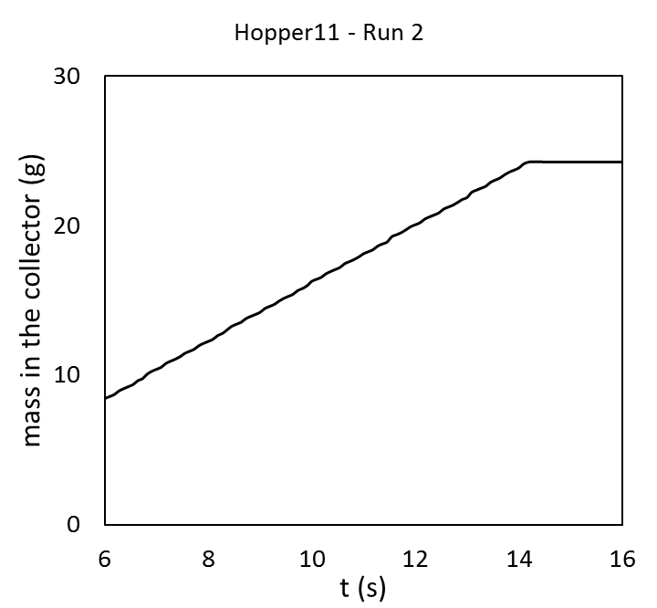
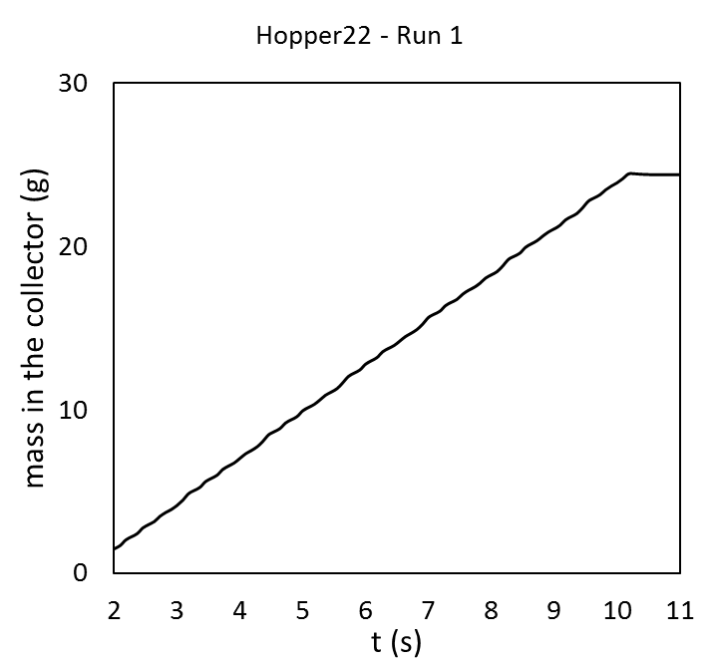
Benchmark problem – Preliminary experiments
Control variables
Orifice diameter
Apex angle
Quantities of interest (QoI)
Discharge flow rate
Angle of repose
Material: High density polyethylene (HDPE)
Geldart B classification
Mean particle diameter: 848 μm
Density: 884 kg/m³
Hopper 11
Hopper 22
Index | θ (deg) | h₁ (cm) | h₂ (cm) | D_{o} (mm) | D₁ (cm)
11 | 13.44 | 10 | 2.5 | 5.8 | 5.36
12 | 13.12 | 10 | 2.5 | 7 | 5.36
21 | 23.63 | 10 | 2.5 | 5.8 | 9.33
22 | 23.34 | 10 | 2.5 | 7 | 9.33

Slide 24
Benchmark problem – Simulation
Parameter | Description | Value
θ | Alex angle/cone half-angle | 13.4°
D₀ | Orifice diameter | 5.8 mm
h₀ | Stem height | 25.0 mm
D₁ | Funnel diameter | 53.6 mm
h₁ | Funnel height | 100.0 mm
D₂ | Collector diameter | 65.0 mm
h₂ | Distance of hopper exit from the base | 35.0 mm

